Slide 1
Correlations Between Major International Summer Tournaments and Defensive Actions Across the Following Seasons in Soccer
Saurav Banerjee and Joshua Park

Slide 2
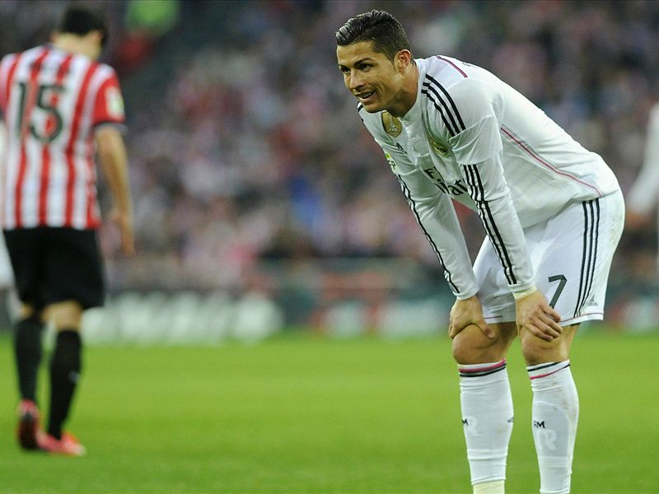
The Problem
Both coaches and players have complained in recent years about increased amounts of matches with inadequate rest
We wanted to see how playing in the World Cup affected fatigue in players, given that this meant they would not have a summer break and instead would have to go straight back to playing.
Notes:
Saurav

Slide 3
Literature Review
104 injuries (1.68 injuries/match) were reported during the 2014 World Cup (Junge & Dvorak, 2015)
Lower injury burden and higher match availability → higher league ranking and success in European competitions (Hagglund et al., 2013)
Sprint performance, measures of muscle contractile function, perceived muscle soreness, and more worsened after 90 minute games for professional players, and full recovery required at least 48 hours (Rampinini et al., 2011)
Mental fatigue has a harmful effect on individual tactical performance in defensive actions (Kunrath et al., 2020)
Notes:
josh

Slide 4
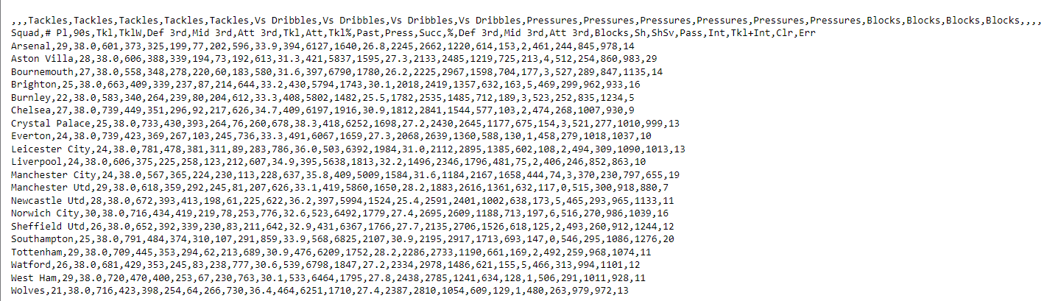
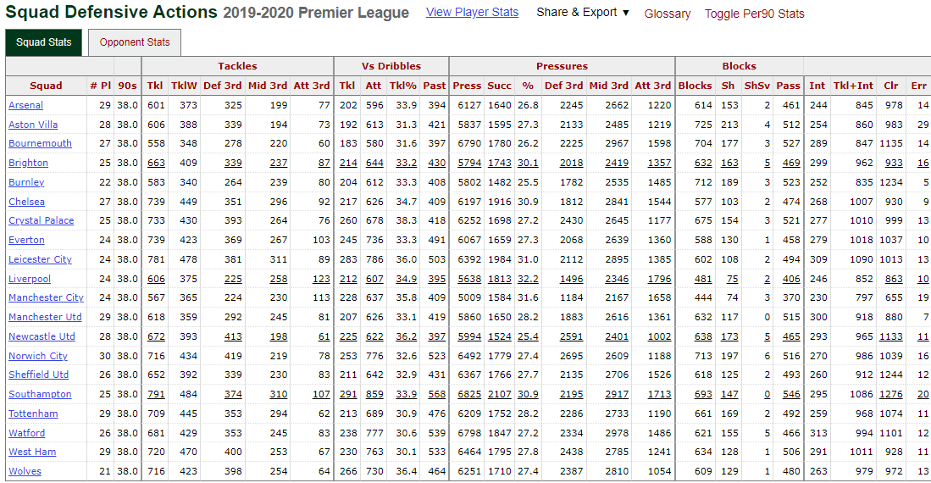
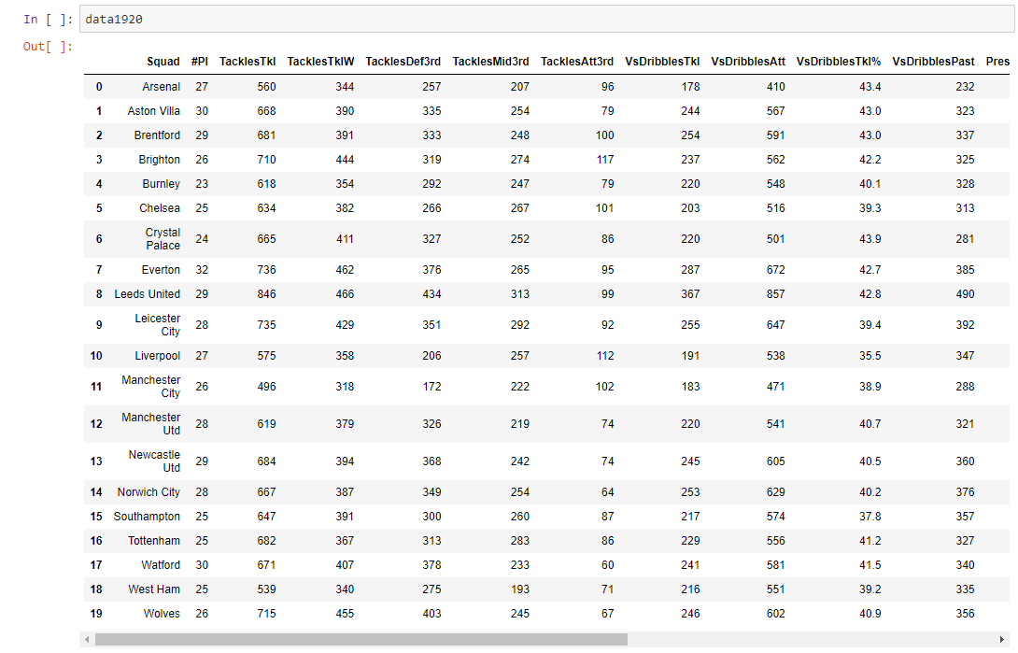
Data Collection
Defensive Actions from FBREF’s datasets from the Premier League → exported them as CSV files → processed and analyzed using Pandas and SciPy in Python.
Notes:
Saurav

Slide 5
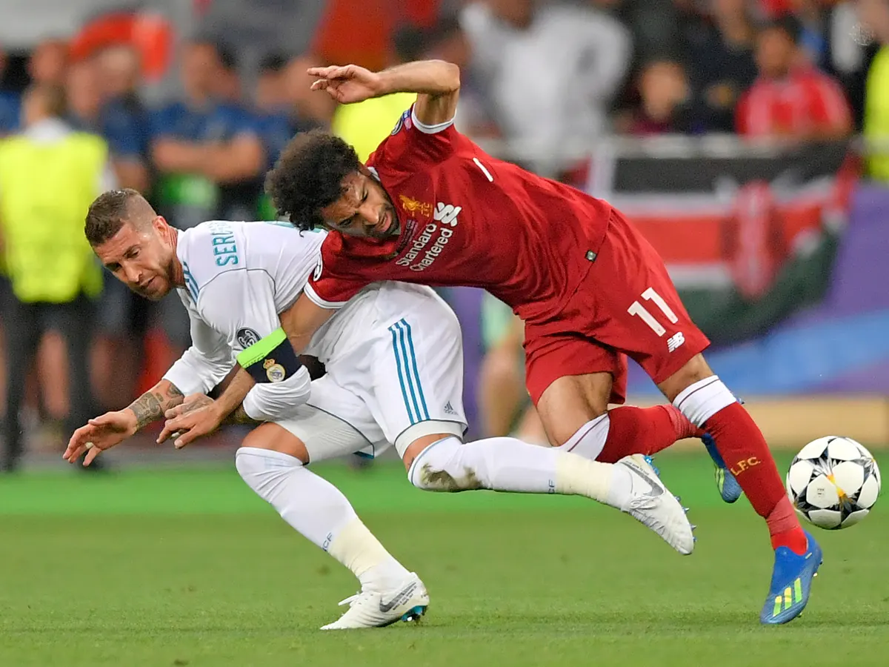
Why Defensive Actions?
Lack of clear dataset on distance traveled
Second best thing to look at is Defensive Actions
Relates to how much effort players can put off the ball
Mental Fatigue In Soccer: A Systematic Review
Reduced tactical and cognitive performance related to defense when fatigued
Notes:
josh

Slide 6
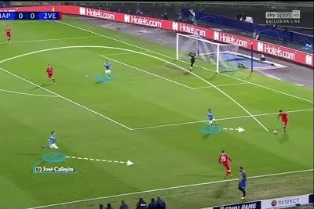
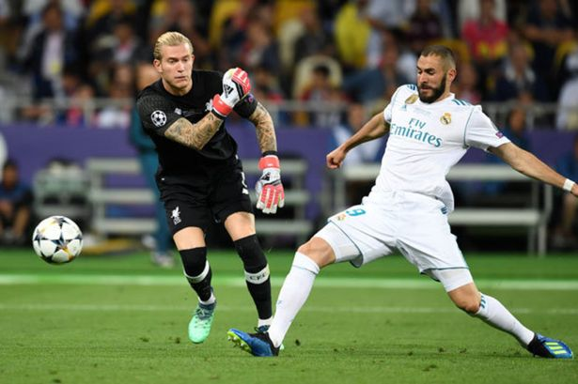
What We Looked At
Out of over 20 options, we chose to focus on two metrics: Pressures in the Attacking Third and Errors
We chose Pressures in the Attacking Third because teams pressing high on the field requires lots of energy → highly affected by fatigue
We chose Errors because mental fatigue → more errors
Notes:
saurav

Slide 7
Hypotheses
Pressures In Attacking Third
H₀: Pressures In Attacking Third 17/18 = Pressures In Attacking Third 18/19 = Pressures In Attack Third 19/20
H_{A}: Means of Pressures In Attacking Third During 17/18, 18/19, 19/20 seasons are Not Equal To Each Other
Errors
H₀: Errors 17/18 = Errors 18/19 = Errors 19/20
H_{A}: Means of Errors During 17/18, 18/19, 19/20 seasons are Not Equal To Each Other
Notes:
saurav

Slide 8
ANOVA Conditions
Random
Two possible years after major summer tournaments we could’ve used based on data available: 2018-2019 or 2021-2022
Flipped coin to use 2018-2019
Years of comparison are the seasons before and after 2018-2019 to control for tactical trends
Each year has element of randomness with relegation
Normality
Not all distributions are approximately Normal, but most are
Equal Variance
All residual plots are roughly equally scattered
Notes:
josh

Slide 9
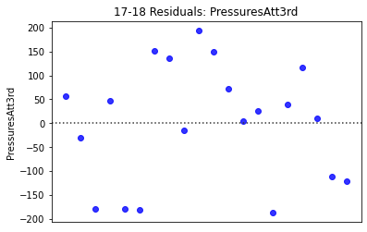
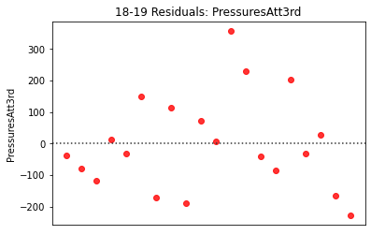
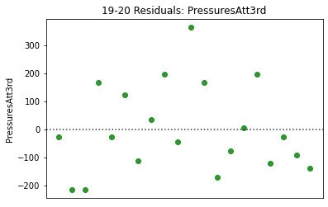
Notes:
josh
plotted using seaborn

Slide 10
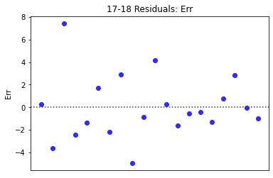
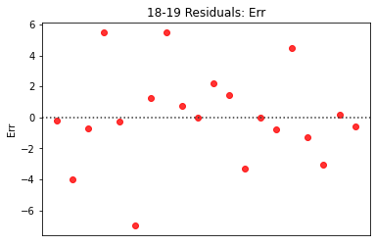
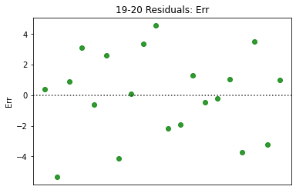
Notes:
josh
plotted using seaborn

Slide 11
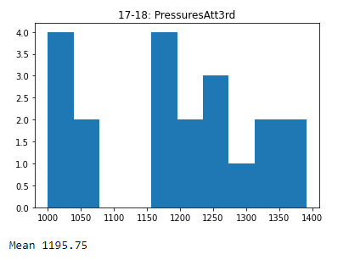
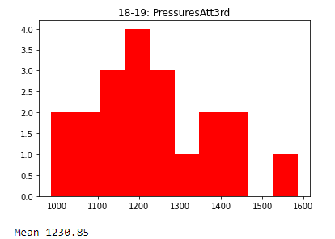
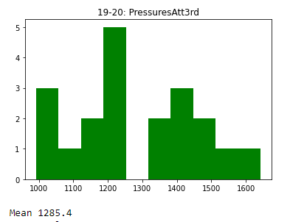

Pressures In the Attacking Third
Notes:
saurav

Slide 12
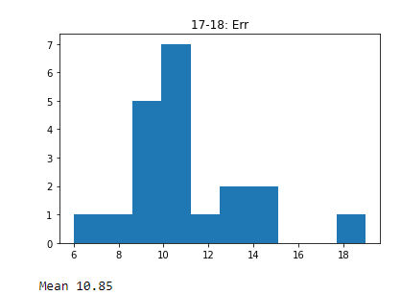
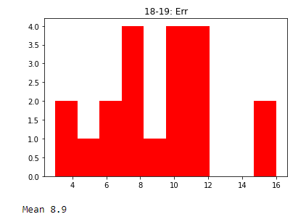
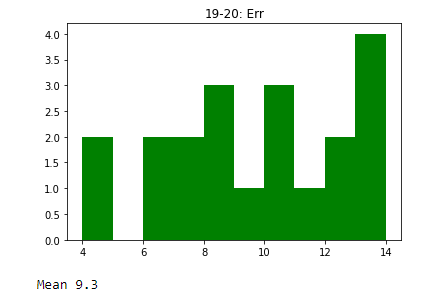
Errors
Notes:
saurav

Slide 13
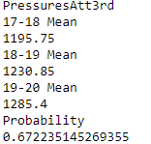
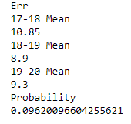
Results
Our ANOVA results were not statistically significant,
Could not conclude that there is any statistically significant differences between years after World Cups and regular soccer years.
However, trends that previous literature have talked about could’ve been covered up by confounding variables.
Notes:
Saurav

Slide 14
Drawbacks/Confounding Variables
Uncertain Link Between Final 3rd Pressures and Fatigue
Players could be playing normally through pain
Teams are Impacted By World Cup Differently
Different Amounts of Players from teams play in the World Cup
Worse teams have less and less World Cup Players
Notes:
josh

Slide 15
Questions?

Slide 16
References
Hägglund, M., Waldén, M., Magnusson, H., Kristenson, K., Bengtsson, H., &amp; Ekstrand, J. (2013, August 1). Injuries affect team performance negatively in professional football: An 11-year follow-up of the UEFA Champions League Injury Study. British Journal of Sports Medicine. Retrieved May 24, 2022, from https://bjsm.bmj.com/content/47/12/738
Junge, A., & Dvořák, J. (2015, May 1). Football injuries during the 2014 FIFA World Cup. British Journal of Sports Medicine. Retrieved May 24, 2022, from https://bjsm.bmj.com/content/49/9/599
Kunrath, C. A., Cardoso, F. da S. L., Calvo, T. G., &amp; Costa, I. T. da. (2020, April 6). Mental fatigue in soccer: A systematic review. Revista Brasileira de Medicina do Esporte. Retrieved May 24, 2022, from https://www.scielo.br/j/rbme/a/Dg9XwsYgLQBKHQgRrpqqgvk/?lang=en#
Rampinini, E., Bosio, A., Ferraresi, I., Petruolo, A., Morelli, A., & Sassi, A. (2011). Match-related fatigue in soccer players. Medicine and science in sports and exercise, 43(11), 2161–2170. https://doi.org/10.1249/MSS.0b013e31821e9c5c

Slide 17
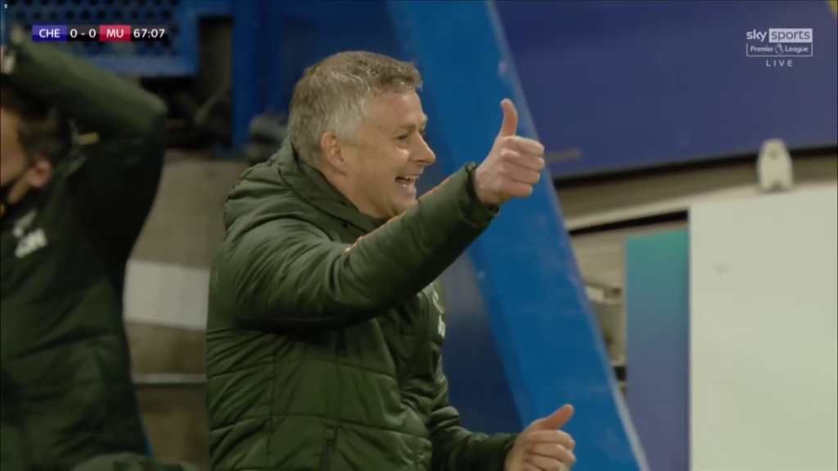
Thanks!

